Slide 2
Introduction to python and Microsoft Student Learn Ambassador
Speaker: Akshat Mittal

Slide 3
Agenda
History
Installing & Running Python
Names & Assignment
Sequences types: Lists, Tuples, and Strings
Loops
Mutability
Jupyter Notebook
Information about MSLA

Slide 4
Brief History of Python
Invented in the Netherlands, early 90s by Guido van Rossum
Named after Monty Python
Open sourced from the beginning
Considered a Programming language, and it is much more
Scalable, object oriented and functional from the beginning
Used by Google from the beginning
Increasingly popular

Slide 5
Installing
Python is pre-installed on most Unix systems, including Linux and MAC OS X
The pre-installed version may not be the most recent one.
Download from http://python.org/download/
Python comes with a large library of standard modules
Download Vs Code from visualstudio

Slide 6
What is Python used for?
1. AI and machine learning
2. Data analytics
3. Data visualisation
4. Programming applications
5. Web development
6. Game development
7. Language development
8. Finance

Slide 7
Practical Time
So now let's move on to coding part. Ps: you can find all code and ppt on Github

Slide 8
What is Microsoft Learn Student Ambassadors?
The Microsoft Learn Student Ambassadors community is for students—like you—who want to use tech to solve real-world problems with like-minded peers, establish themselves as mentors and leaders in their community, and amplify their impact.
Student Ambassadors get the opportunity to connect with other students around the world (from 102 countries and counting!), foster their own online communities, get training and earn certifications, and tackle practical challenges, all while building key technical and soft skills to help them succeed. They can also make meaningful progress on the socially significant issues that they care about.

Slide 9
Who’s eligible to apply to the program and what experience do you need?
There is only one requirement, and it is:​
​
You must be at least 16 years old and actively enrolled in a higher education academic institution to apply.
Microsoft supports students from all academic backgrounds and ages who want to learn, grow, and help others.

Slide 10
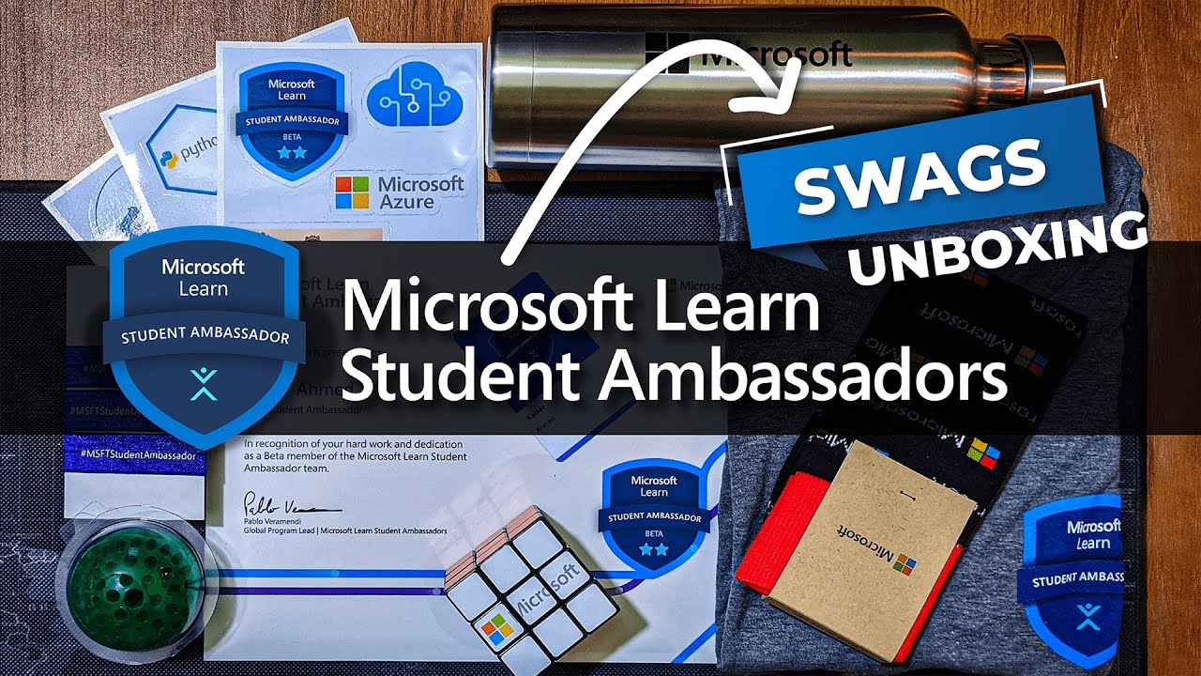
What resources and benefits can Microsoft Learn Student Ambassadors get access to?
There are endless opportunities and benefits for you followed as:
Visual Studio Enterprise Subscription and $150 monthly Azure Credit
Event Support
MTC certification exam voucher
Access to Office 365, plus TechSmith Snagit and recording software
Swags and mentorship benefits

Slide 11
Thank You

